Slide 2
Light electric truck (18 tonnes) with a daily mileage of 150 km with 120 kW drive power from electric motor.
Battery Storage Systems SS 22

Slide 3
Agenda
Introduction
Battery Technology Selection
Battery Cell Selection and Pack Design
Battery Management System and Cooling System
Load Profile Estimation
Ageing
Cost Analysis
Conclusion

Slide 4
Introduction
Source : https://www.researchgate.net/publication/336687173

Slide 5





Battery Technology
Criteria for choosing the battery technology for full-hybrid vehicles:
Gravimetric and volumetric power density
Gravimetric and volumetric energy density
Energy efficiency
Calendar lifetime
Cylce lifetime
Costs
Considered Technologies:
Lead-acid (Pb)
Nickel-cadmium (NiCd)
Nickel-metal hydride (NiMH)
Lithium-ion (Li-ion)
Sodium-nickel chloride (NaNiCl₂)

Slide 6
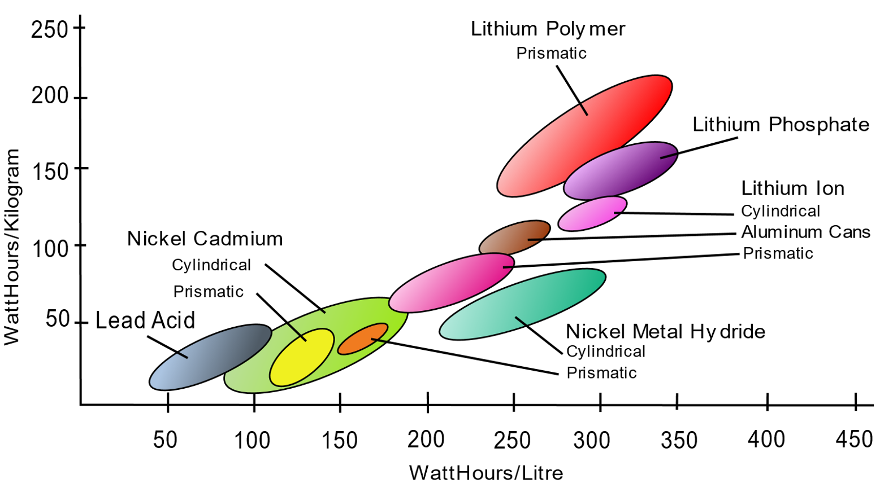
Battery Technologies – Volumetric Energy Density
Volumetric Energy Density¹
Technology | Volumetric Energy Density
Lead-acid (Pb) | --
Nickel-cadmium (NiCd) | -
Nickel-metal hydride (NiMH) | o
Lithium-ion (Li-ion) | +
Sodium-nickel chloride (NaNiCl₂) | +
1: https://upload.wikimedia.org/wikipedia/commons/c/c9/Secondary_cell_energy_density.svg

Slide 7
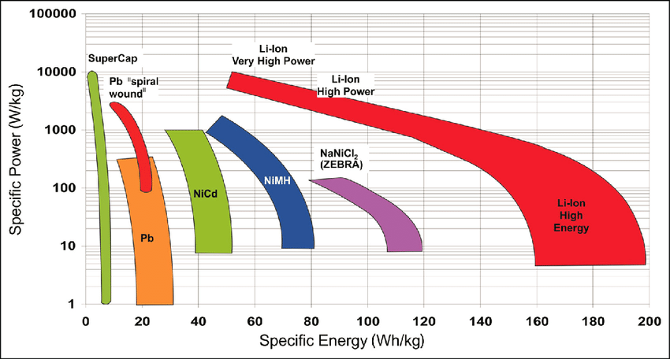
Battery Technologies – Gravimetric Power- and Energy Density
Gravimetric Energy-and Power Density¹
Technology | Theoretical Minimum Weight for 70 kW Power and 1 kWh Capacity | Critical Factor
Lead Acid | 200 kg | Power
NiCd | 70 kg | Power
NiMH | 37 kg | Power
Lithium Ion | 14 kg | Energy
NaNiCl₂ | 460 kg | Power
: Considered Point for this application:
For most technologies, the gravimetric power density is more critical for the given application
1: Budde-Meiwes, Heide & Drillkens, Julia & Lunz, Benedikt & Muennix, Jens & Lehner (maiden name Rothgang), Susanne & Kowal, Julia & Sauer, Dirk. (2013). A review of current automotive battery technology and future prospects. Proceedings of the Institution of Mechanical Engineers, Part D: Journal of Automobile Engineering. 227. 761-776. 10.1177/0954407013485567

Slide 8
Battery Technologies – Overview
Technology | Efficiency^{[1][2][3]} | Lifetime | Costs | Power Density | Energy Density | Safety | other
Lead Acid | ~ 85 % | - | ++ | - | -- | + | Highest recycling quotes of all technologies (>95 %)
NiCd | 70 % - 85 % | + | - | o | - | - | Mature technology
NiMH | 70 % - 80 % | + | - | + | o | o | Poor deep-temperature performance
Lithium Ion | 85 % - 98 % | ++ | - | ++ | ++ | o | Do not offer a mechanism for overcharging
NaNiCl₂ | 78% - 85 % | + | - | -- | + | o | High operating temperature (300 °C)
[1] Soloveichik, Grigorii L.. “Battery technologies for large-scale stationary energy storage.” Annual review of chemical and biomolecular engineering 2 (2011): 503-27
[2] https://www.sciencedirect.com/topics/earth-and-planetary-sciences/nickel-cadmium-battery#:~:text=NiCd%20batteries%20cool%20as%20they,have%20claimed%20up%20to%2085%25.
[3] https://www.sciencedirect.com/topics/engineering/ah-efficiency#:~:text=Lead%E2%80%93acid%20batteries%20typically%20have,the%20higher%20is%20the%20efficiency
Lithium-ion battery meets the criteria for this application best

Slide 9
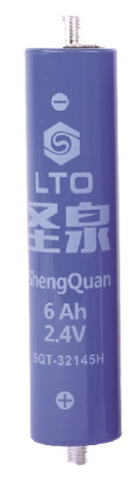
Battery Cell
Capacity
Rated Voltage
Charge cut-off voltage
Discharge cut-off voltage
Shape (diameter x length)
Charge/discharge cycles (25°C, 1C)
Operating temperature
Weight
Short-term max. current (10s)
Continuous discharge current
Continuous charge current
Price per cell
Source:...

Slide 10
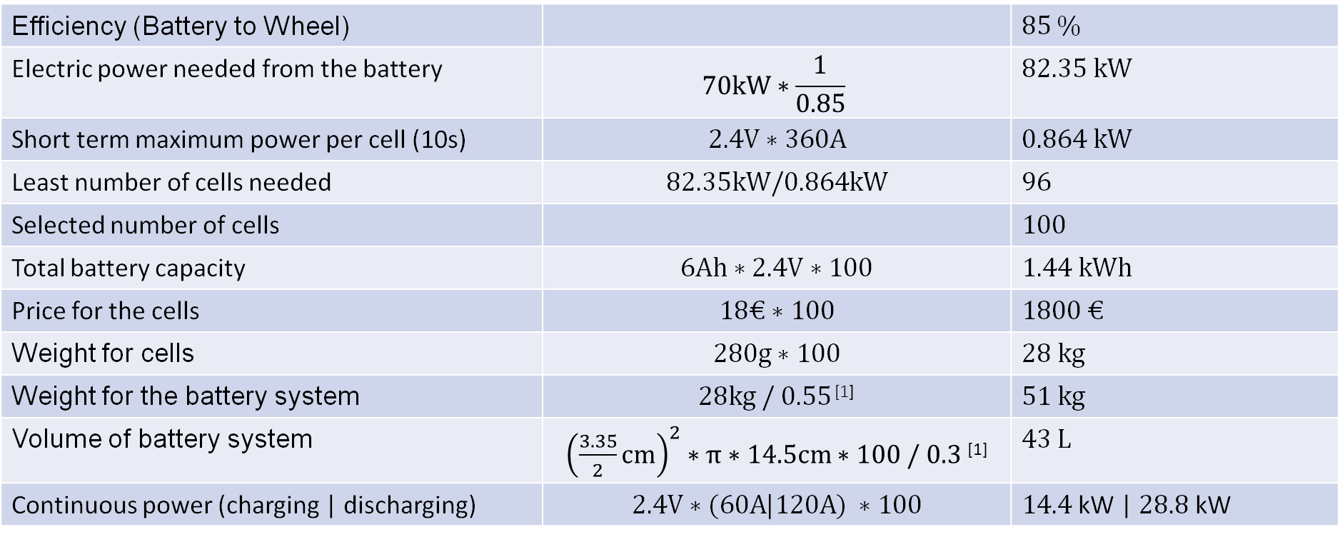
Battery Pack Design
Efficiency (Battery to Wheel) |  | $$85 \%$$
Electric power needed from the battery | $$70kW∗\frac{1}{0.85}$$ | $$82.35 kW$$
Short term maximum power per cell (10s) | $$2.4V∗360A$$ | $$0.864 kW$$
Least number of cells needed | $$82.35kW/0.864kW$$ | $$96$$
Selected number of cells |  | $$100$$
Total battery capacity | $$6Ah∗2.4V∗100$$ | $$1.44 kWh$$
Price for the cells | $$18€∗100$$ | $$1800 €$$
Weight for cells | $$280g∗100$$ | $$28 kg$$
Weight for the battery system | $28kg /$ $0.55$ ^{[1]} | $$51 kg$$
Volume of battery system | ${\left(\frac{3.35}{2}cm\right)}^{2}∗π∗14.5cm∗100 / 0.3$ ^{[1]} | $$43 L$$
Continuous power (charging | discharging) | $$2.4V∗(60A|120A) ∗100$$ | $14.4$kW | $28.8$ kW
1:Hendrik Löbberding, Saskia Wessel, Christian Offermanns, Mario Kehrer, Johannes Rother, Heiner Heimes and Achim Kampker; From Cell to Battery System in BEVs: Analysis of System Packing Efficiency and Cell Types; World Electric Vehicle Journal 2020, 11, 77; doi:10.3390/wevj11040077

Slide 11
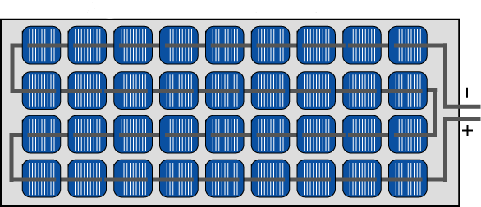
Topology Selection
Cells are connected in series in our battery pack design
Nominal voltage: 240 V
Criteria for selection of this topology
Typical voltage level of Hybrid vehicles are 200-400V^{[1]}
Parallel or modular connection of the same voltage would result in a much larger energy capacity than required, making it economically worse and increasing the weight
Less complex BMS required
Problem with the selected topology
Low reliability – worst cell limits the lifetime
Less control over each section than modular
1: Budde-Meiwes, Heide & Drillkens, Julia & Lunz, Benedikt & Muennix, Jens & Lehner (maiden name Rothgang), Susanne & Kowal, Julia & Sauer, Dirk. (2013). A review of current automotive battery technology and future prospects. Proceedings of the Institution of Mechanical Engineers, Part D: Journal of Automobile Engineering. 227. 761-776. 10.1177/0954407013485567
Source: pveducation.org

Slide 12
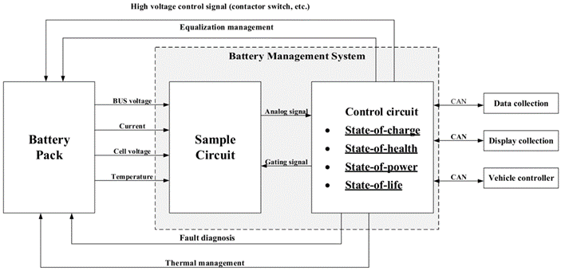
Battery Management System
Functions:
Monitoring
Voltage, current, temperature
Protection
Against undervoltage
Too high current
Fixed temperature limit: 60°C
Charging and discharging Management
Balance SOC of the cells
Communication
With vehicle control unit
Diagnosis
SOH, total number of cycles
Requirements:
Avoid Electromagnetic Interference (EMI)
Contactors
Redundancy
Galvanic Isolation
Source: mdpi.com

Slide 13
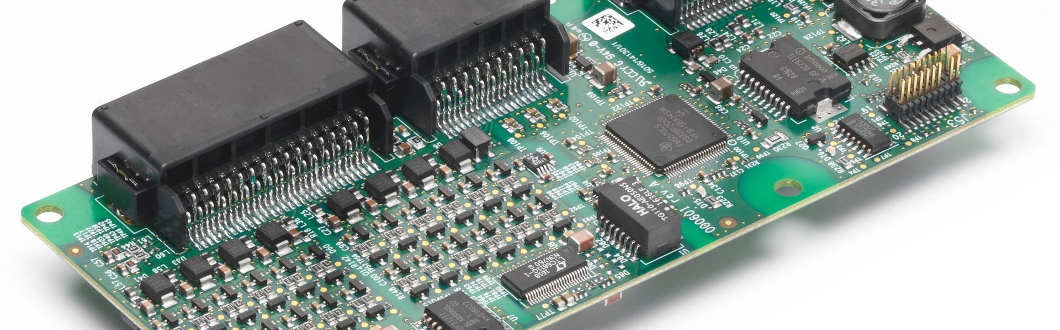
Battery Management System
Centralized topology
Single master module is connected to the cells serially
Advantages:
Cheap
Less maintenance
Good accuracy
Disadvantages:
Limited scalability and flexibility
Less reliability
Bus Voltage/ Current Measurement
Charging System
Internal Power Supply Module
Thermal Management Module
Temperature Sensor Array
Balancing Control Mode
Cell Voltage Measurement
High Voltage Safety Control
General Analogue Inputs
Communication Module
General Digital Inputs
Man-machine interface Module
Global Clock Module
General Digital Outputs
Source: Characteristics of Battery Management Systems of Electric Vehicles with Consideration of the Active and Passive Cell Balancing Process. Muhammad Uzair, Ghulam Abbas and Saleh Hosain
Source: lithiumbalance.com

Slide 14
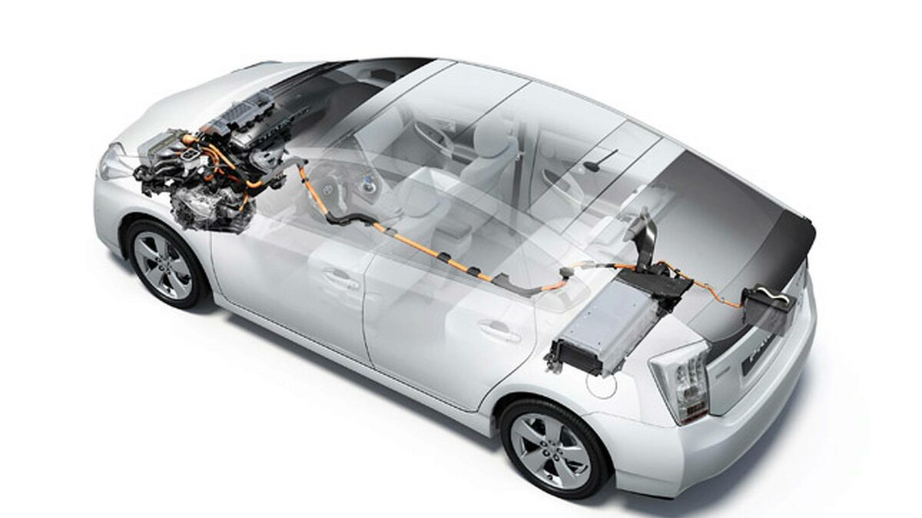
Cooling system
Active air cooling
Keeping battery between 20 - 40ºC
Shared use of passenger compartment air conditioning
The system has a fan activated by the battery control unit
Four temperature sensors:
one in the air intake area and the other three along the battery module
Ventilation inlets near the rear seats and outlet in the car boot
Low weight
Source: autofacil.com

Slide 15
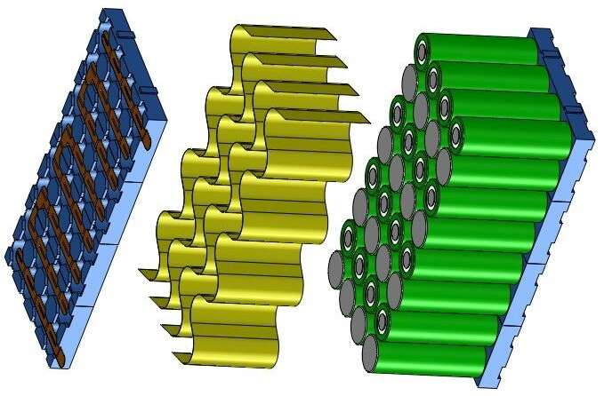
Cooling system
Heat spreaders:
Graphite sheets coated with thin dielectric films or thermally conductive metal foils
Flexible heat spreaders can weave between cells before terminating at heat sinks
Heat sink with a high level of thermal conductivity:
aluminium, copper, etc.
Homogeneous temperature distribution
Temperature gradient less than 5ºC
Energy efficient
Low cost
Source: edn.com

Slide 16
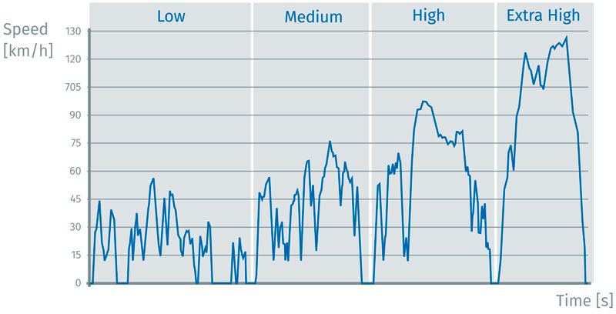
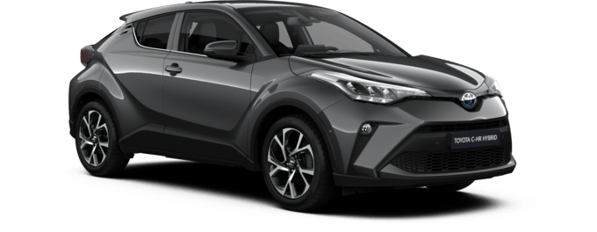
Load Profile Estimation
Use velocity and acceleration of WLTP cycles
Distance: 23.3 km, duration: 30 min
Calculate the energy needed for every 1-second-interval
Calculate the SOC of the battery during the cycle
Drive electric under 38 km/h
Properties of the Toyota C-HR used
Source: Toyota
Source: csm.de

Slide 17
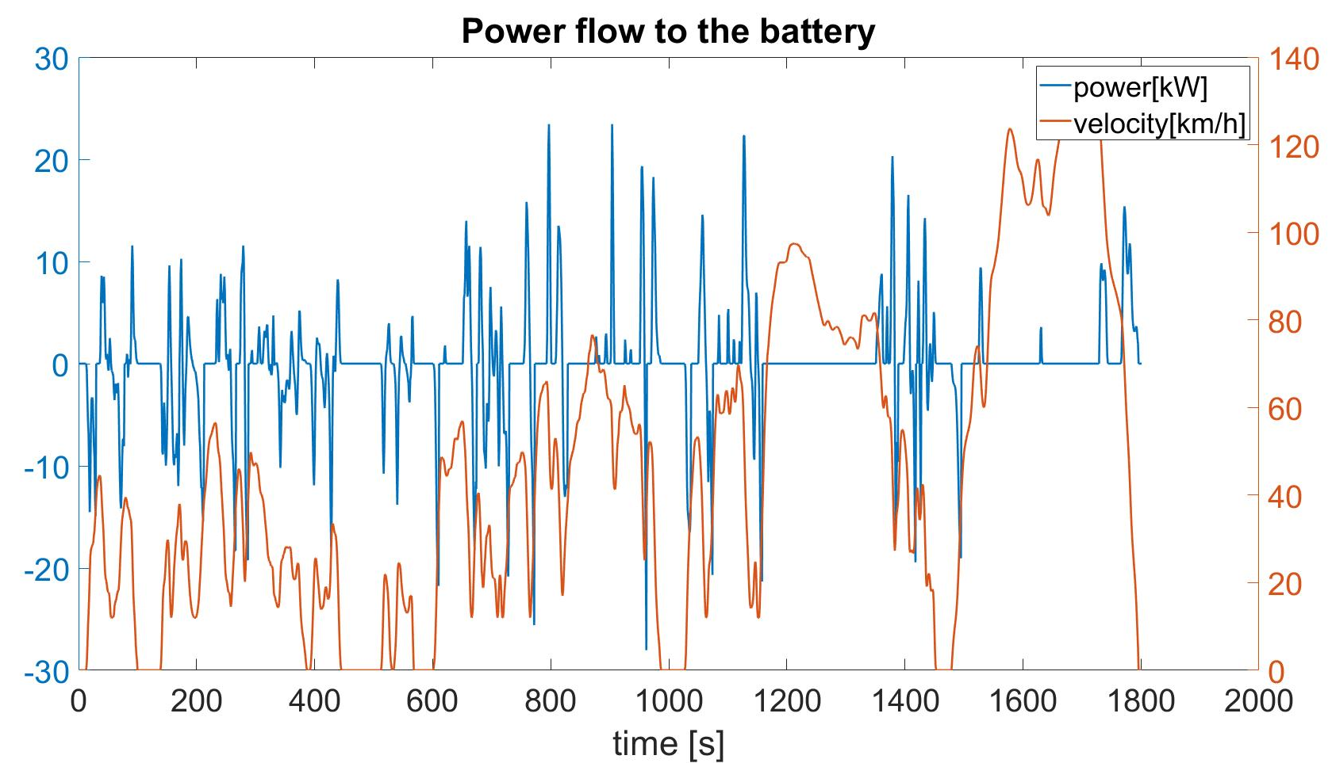
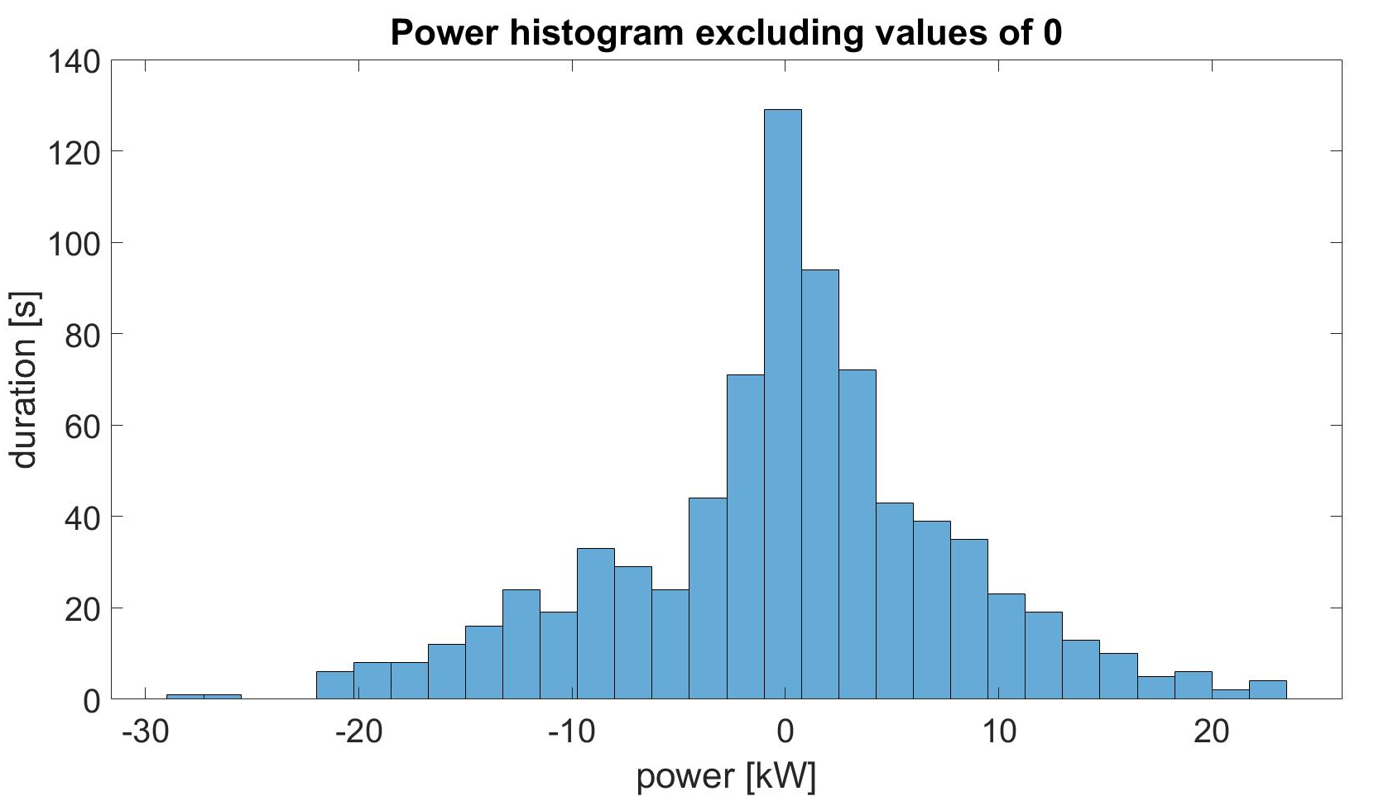
Load Profile Estimation – Power
Average power: 10.9 kW (7.6 C at 2.4 V - 9.1 C at 2.0 V)

Slide 18
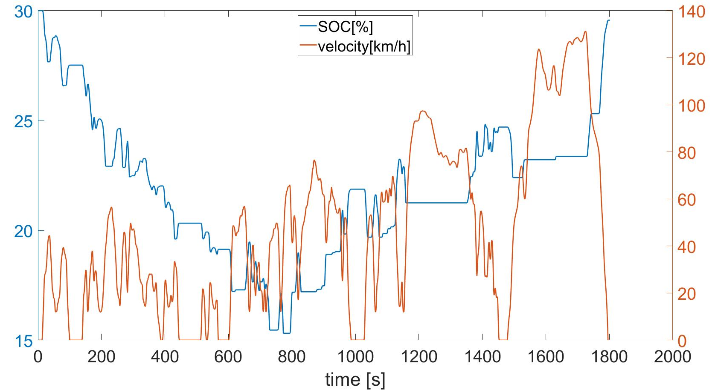

Load Profile Estimation – SOC
Average DOD per cycle: 3 % (= 43.2 Wh)
Total amount of energy charged/discharged: 0.65 kWh
Assume 15 cycles of 3 % DOD during a 23.3 km drive
Fuel savings: 20.6 % (from 6.2 l/100km to 4.9 l/100km)
In city driving conditions a fuel reduction of 41.7 % is possible
Duration
0
SOC[%]
100

Slide 19
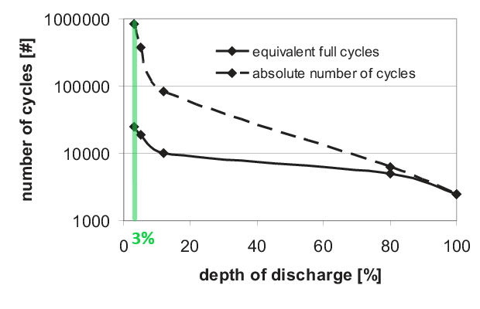
Cyclic Ageing Estimation
Average DOD of 3% per cycle
From the Wöhler curve it yields 10⁶ cycles
From Load profile, 15 cycles per 23.3 km
Total driving distance of 1 553 333 km in its cycle lifetime
Inaccuracy in our assumption
The curve is for conventional Li-ion batteries, LTO's have better cycle life
In the curve C rate is 1 whereas average C rate is 9C
Variance in cell quality would affect ageing
Effect of calendric ageing on cyclic ageing not considered
Cyclic Life Tests
Varying DOD, C rate and Temperature
Source: Encyclopedia of Electrochemical Power Sources, Editor-in-Chief Jürgen Garche, Elsevier, 2009, page 522-538
Lifetime prediction Dirk Uwe Sauer a, Heinz Wenzl b

Slide 20
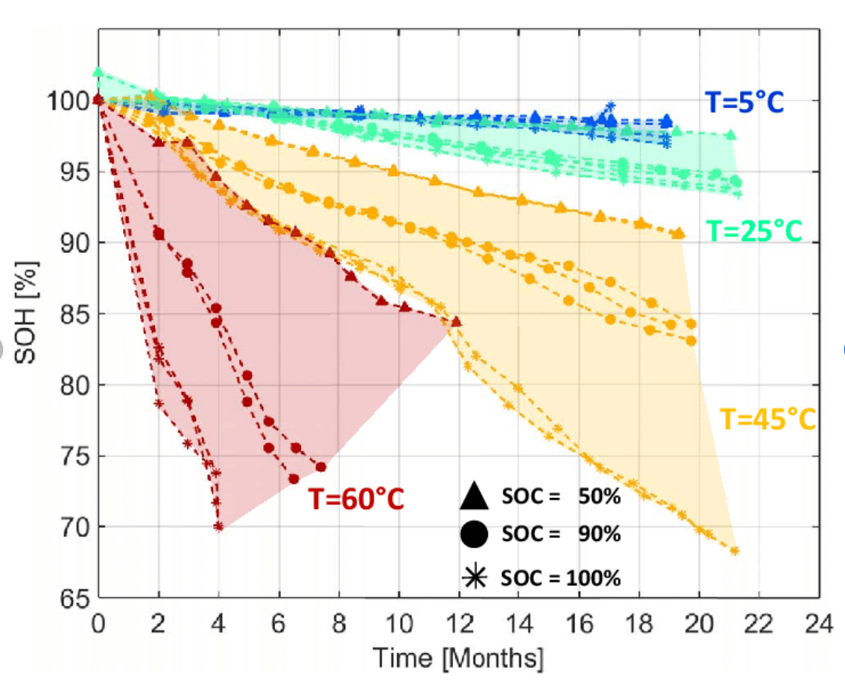
Calendric Ageing Estimation
Assumption of the resting SOC is 50%
Assumed temperature is 25° C
SOH drops 3% in 21 months
With extrapolation, SOH of battery would drop below 80% after 140 months or 12 years
Inaccuracy in our assumption:
Resting SOC would vary
Variance in Temperature is not considered
The curve is for conventional Li-ion batteries
Calendric ageing would be affected by variance of cell quality as well
Calendric Life Tests
Varying SOC and Temperature
Source: Effects of Biphenyl Polymerization on Lithium Deposition in Commercial Graphite/NMC Lithium-Ion Pouch-Cells during Calendar Aging at High Temperature
Bramy Pilipili Matadi,a,b Sylvie Geni`es,c,d Arnaud Delaille,a,b,zThomas Waldmann,e Michael Kasper,eMargret Wohlfahrt-Mehrens,eFrederic Aguesse,fEmilie Bekaert,f
Isabel Jim´enez-Gordon,c,d Lise Daniel,c,d Xavier Fleury,c,d Michel Bardet,g Jean-Fr´ed´ eric Martin,c,d and Yann Bultelh,

Slide 21
Cost Analysis
Hybrid car components
Battery
Cooling system
Power Electronics
BMS-System
Safety components
Electric motor
Total costs: 5000 € ^{[1,2]}
Break-Even-Point:
Gasoline price: 1.70 € per liter
20.6%: (231 000 km, 24 340 €)
41.7%: (114 000 km, 12 010 €)
1:https://www.greengear.de/hybridantrieb-paralleler-hybrid/
2:https://www.toyota.de/download/cms/dede/P50826_Toyota_Edition-S_SoMo_Web_tcm-17-694546.pdf

Slide 22
Conclusion
High power Li-Ion Battery (LTO)
Connected in series for high voltage
Sufficient to power the electric motor at maximum power for 10s
Can provide 14.4 kW (charging) / 28.8 kW (discharging) continuously
Active air cooling
Lifetime: 1.55 Mio km or 12 years
Fuel savings 20.6 % (in city driving conditions 41.7%)
Total extra cost for the hybrid system 5000 € (1800€ for the cells only)
After 230 000 km it will be cheaper than a conventional car

Slide 23
Full hybrid vehicle with an electric machine of 70 kW motor power
Battery Storage Systems WS 21/22

Slide 24
Backup - Load Profile Estimation
For every 1-second-interval
coefficient | value
mass | 1460kg ¹
Cw value | 0.31 ²
area | 2.45 ²
Rolling resistance factor | 0.013 ³
intertial force
*1s
velocity
acceleration
*v
power
drag force
rol. res. force
Regenerative breaking: E < 0
¹toyota.de
² automobil-guru.de
³engineeringtoolbox.com
energy
15% losses
SOC
fuel consumption
15% losses
Electric driving: v < 38
Combustion driving: v > 38

Slide 25
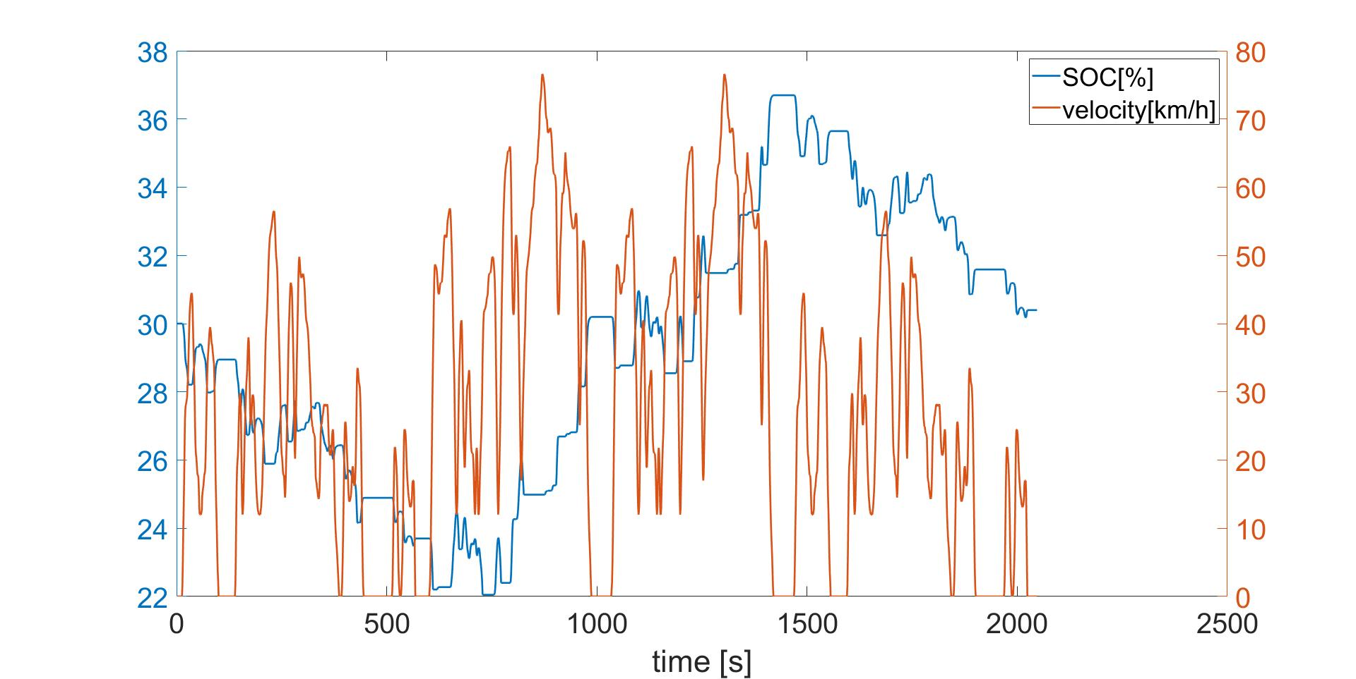
Backup - Load Profile Estimation
Second Scenario: low and medium speed – now drive electric up to 32 km/h
Assume 16.8 cycles of 3 % DOD during a 15.7 km drive
Fuel savings: 41.7 %

Slide 26
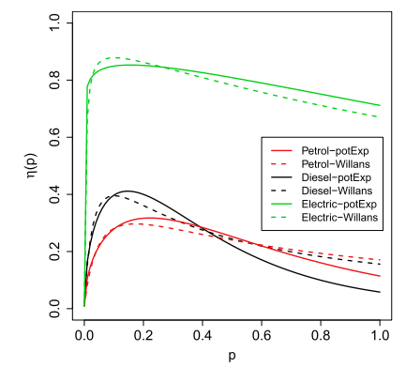
Backup - Tank-to-wheel efficiency
Odd André Hjelkrem, Petter Arnesen, Torstein Aarseth Bø, Rebecka Snefuglli Sondell,
Estimation of tank-to-wheel efficiency functions based on type approval data,
Applied Energy, Volume 276, 2020
https://doi.org/10.1016/j.apenergy.2020.115463

Slide 27
Backup - Battery Technologies – Power Density
Gravimetric Energy-and Power Density¹
Technology | Gravemetric Energy Density | Gravemetric Power Density
Lead-acid (Pb) | -- | -
Nickel-cadmium (NiCd) | - | o
Nickel-metal hydride (NiMH) | o | +
Lithium-ion (Li-ion) | ++ | ++
Sodium-nickel chloride (NaNiCl₂) | + | --
: Considered Point for this application:
1: Budde-Meiwes, Heide & Drillkens, Julia & Lunz, Benedikt & Muennix, Jens & Lehner (maiden name Rothgang), Susanne & Kowal, Julia & Sauer, Dirk. (2013). A review of current automotive battery technology and future prospects. Proceedings of the Institution of Mechanical Engineers, Part D: Journal of Automobile Engineering. 227. 761-776. 10.1177/0954407013485567

